Slide 1


SMART VOTING
SYSTEM
PRESENTED BY
KEERTHANA J - 210701118
THOUFEEQ MOHAMMED M - 210701503

Slide 2

ABSTRACT
The proposed system integrates Arduino technology with electoral processes in order to eliminate manual errors and fraud, thus improving the integrity and efficiency of elections. This means that voters can have an interface which will allow them click on switches meant for each political party so as to select their desired candidates hence minimizing chances of mistakes in the counting process. The LCD screen also has a display panel showing the selected candidates and votes counted presently in this way; it helps the people vote honestly because they can see their marked choice. Additionally, there is a button on which once pressed, calculates results automatically making it easy to know who won by how many votes before announcing winners. The goal of this project is therefore to bring voting practices into the modern era while advancing equality, precision, responsibility and trust among democratic societies.

Slide 3
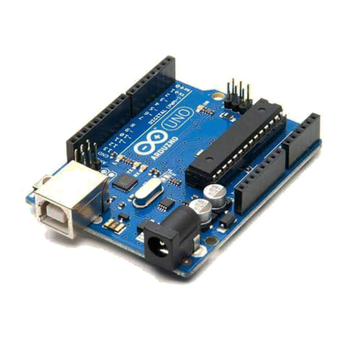
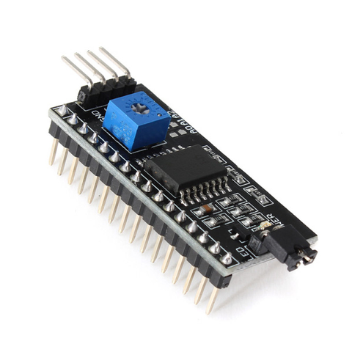
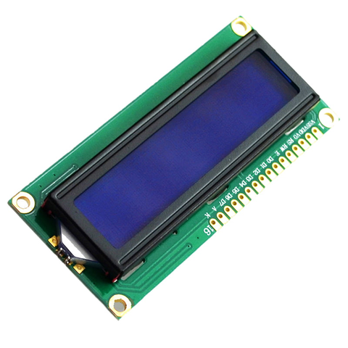
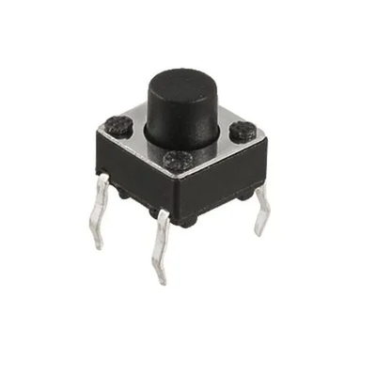
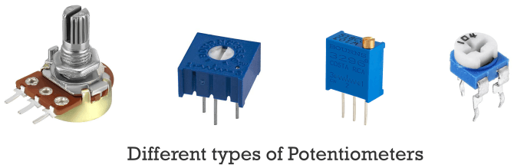
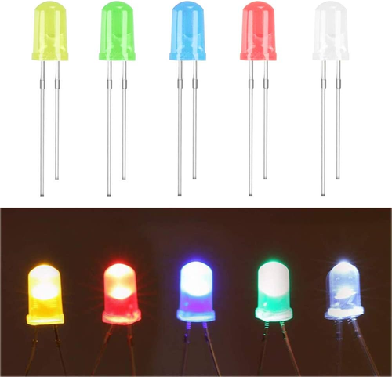
COMPONENTS USED
Arduino UNO Bread
i to c Module
LCD Display Module
Push Button - 5
Potentiometers
LED

Slide 4
Objective
Arduino UNO Board
One popular kind of microcontroller board is Arduino Uno that is dependent on the ATmega328P microcontroller. Recognized widely is the most as well as most versatile and easy to use board in the Arduino family of the Uno board because of the wide community support available.
LCD Display
In IoT (Internet of Things) space and place, the Liquid Crystal Display (LCD) mops the attention to users become a user interface component for facing the characteristics of visual representations embedded in the broader complexity of an IoT device like the presentation of notifications or the description of warnings, etc.
Bread Board
The device that can be prototyped using Breadboard technology is the remote measurement of temperature and humidity data. The prototype will involve three components: the IoT device that will be responsible for measuring, the relay, and a fan.

Slide 5
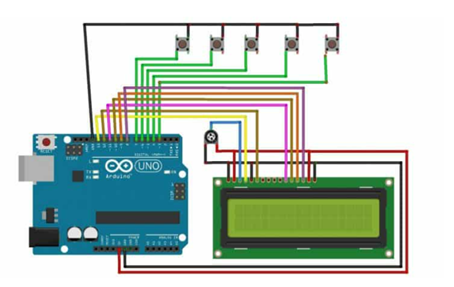
CIRCUIT DIAGRAM

Slide 6
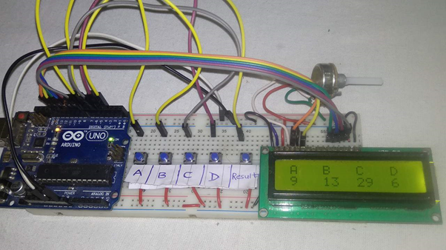
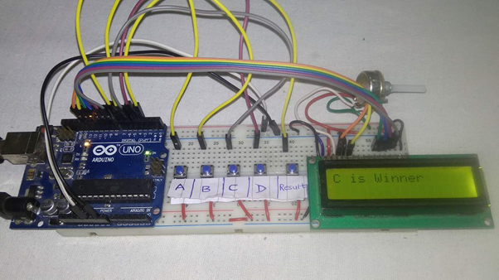
OUTPUT

Slide 7

CONCLUSION
The smart voting technology is a huge step forward in modernizing and protecting the election process. Its deployment resulted in numerous significant benefits. For starters, it has significantly increased the efficiency of voting operations, lowering wait times and expediting the ballot-counting process. Second, the system has improved election accuracy and integrity by incorporating technology like biometrics and block chain to assure vote validity and prevent tampering or fraud. Furthermore, the emphasis on accessibility has made voting more convenient and inclusive, particularly for rural or impaired voters.

Slide 8
THANK YOU

